Slide 1
Developing Analytical Software for Clinical Trials with R
Steven Schwager
Medidata Solutions & Cornell University
Jason Mezey
Cornell University & Medidata Solutions
September 7, 2018

Slide 2

Objective: To make clinical trials faster, better, & cheaper! Why needed?
Notes:
The output of every clinical trial is a data set. We assume the data quality is good enough to achieve our scientififc, regulatory and business objectives.
However, we have reviewed 30 trials using our technology and the results are concerning!

Slide 3
FDA
Approved
Low success rate
~10
Years
Long timelines
~$2.6
Billion
High development cost
Notes:
What has happened so far?
1- Success rate is low, 10%... How much of this is because of a lack of genomic biomarkers, or b/c data quality is suspect?
2- Clinical development timelines are too long! 10 years from Discoveries to Approval. How much of this time is lost due to picking inefficient sites or study designs?
On average, it takes at least 10 years for a new medicine to complete the journey from initial discovery to the marketplace
3- Cost is high $2.6 billion average cost to develop and gain marketing approval for a new drug
What business/scientific decisions could be made better and lead to better outcomes? How do they match to our solutions…
One example theres a 31% success rate for Phase II trials. Synthetic Control Arms are paired with Phase I single arm trials to help predict the results of a subsequent trial. This helps Go/No-Go decisions clearer and should drive up the 31% success rate of Phase II.

Slide 4
The Plan: Improve clinical trial planning, execution, data management, and analysis
Crucial new approach: Innovative analytics for all aspects of a trial – & for portfolio of trials and at industry scale
Planning: Huge topic for a different talk
Execution: Site performance – recruitment & retention, data generation (complete & accurate), more
Data management: Data collection (EDC) & quality assurance; data integration: traditional (site & lab), omics, mHealth, imaging, RWD, & additional data
Analysis: Another huge topic for a different talk

Slide 5
The role of R in developing innovative analytical software for clinical trials
Valuable tool: R is a powerful, flexible computing environment with broad capabilities
R is applicable to all these aspects of clinical trials
Data Science at Medidata: Analytical software is developed & implemented primarily in R & SAS
R has major strengths for developing innovative methods for new problems or new approaches to familiar ones
Focus in this talk: Data quality & genomic data in R

Slide 6
Improving data quality with machine learning
Notes:
The output of every clinical trial is a data set. We assume the data quality is good enough to achieve our scientififc, regulatory and business objectives.
However, we have reviewed 30 trials using our technology and the results are concerning!

Slide 7
Magnitude of the Task is HUGE!
The 5 Vs of Big Data:
Volume, Variety, Velocity, Variety, Value
Variety of data: continuous, ordinal, nominal, time series, images, …
Bivariate relationships reveal outliers that are in range for each component but not for the pair
Many potential types of anomalies

Slide 8
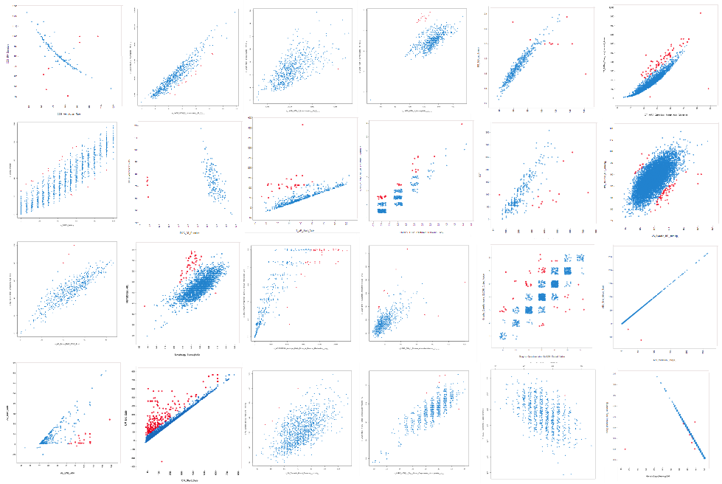
Identifying Relationships using ML

Slide 9
Flagging Outliers using ML

Slide 10
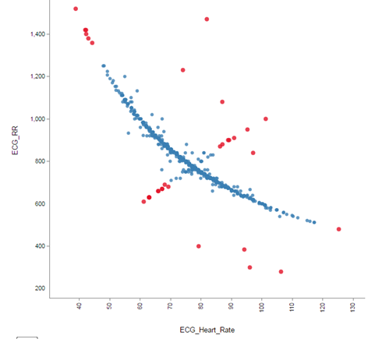
Example 1: Two ECG-related variables
Notes:
For example, a site’s ECG machine might be broken.

Slide 11
Notes:
For example, a site’s ECG machine might be broken.

Slide 12
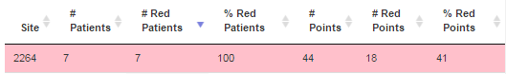
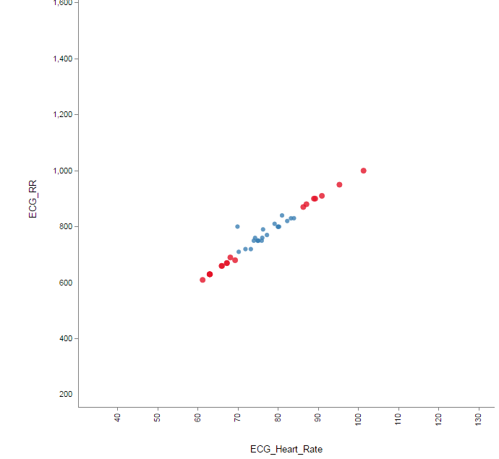
ECG Data Anomalies at One Site

Slide 13
Example 2: Initial Examination of Data Quality
40 Studies (Pivotal Phase 2/3) all intended for regulatory submission
28 Sponsors (small biotech to large pharma)
Sample Size Range: 45 - 4250
Included assessment from former FDA statistical reviewers
Data Quality Issue | Percent of the 40 Studies with Issue
Substantial Data Inconsistencies Within and between CRF’s | 100%
Unreported Adverse Events Compared to Lab/Hosp/Exposure/etc. Records | 95%
Substantial Differences Among Sites or Counties AE Reporting, Protocol/Subject Compliance, Calibration | 87.5%
Site Misconduct Unusually low variability, Data fabrication | 20%

Slide 14
Summary of Initial Examination of Data Quality
Important Caveat: Studies are not random sample
Most EDC data are correct, but errors can have a significant impact on speed and success of study
Substantial fraction of data quality issues cannot be identified by SDV (source data verification)
Site performance is not equal, some are significantly worse
Most sites make mistakes in specific areas (which may differ from site to site)

Slide 15
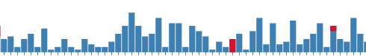
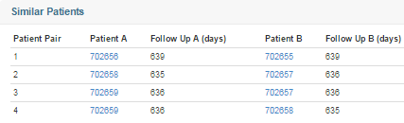
Example 3: Patient Similarity Analysis
Notes:
CSA can distinguish good data from fake data. The last three slides were from a real sponsor, a real study, a real site, that enrolled fake patients.

Slide 16
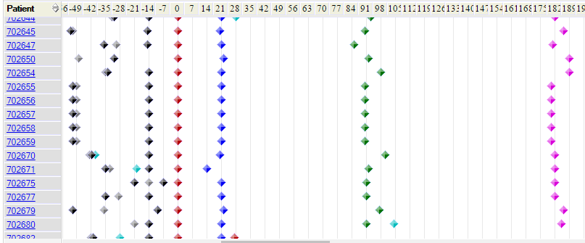
Patient Visits
Good Site
Questionable Site
Notes:
The visits might be too regular.

Slide 17
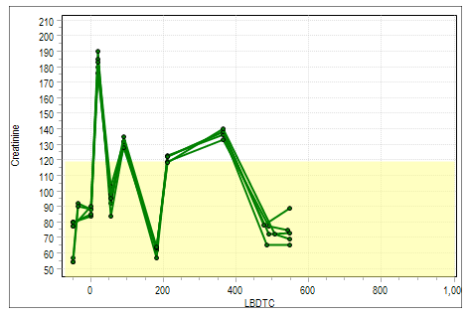
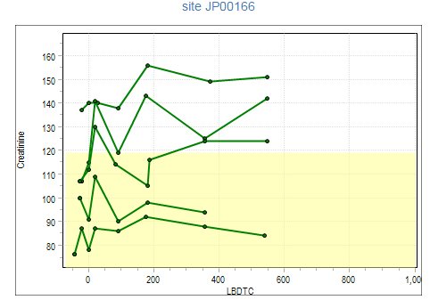
Labs
Questionable Site
Good Site
Notes:
The labs might be too consistent.

Slide 18
Investigation of the Questionable Site
Sponsor found:
All 5 patients were completely fabricated
Site had been entering fake data for 2 years without detection

Slide 19
Example 4: Avoidable Data Quality Issues in 10 Studies by a Top 25 Global Pharma Company
Note: Issues due to misconduct were not all marked as issues with potential approval impact because they were not found on the primary or secondary efficacy variables
Notes:
Potential Misconduct

Slide 20
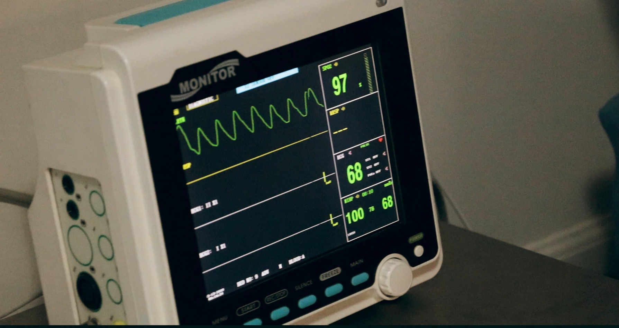
Image:
• Sent to Back
• Adjust image transparency to make text readable
26%
of avoidable data quality issues – 118 of 453 issues – found across 10 studies had potential to delay drug approval

Slide 21
Incorporating genomic data into clinical trials
Notes:
The output of every clinical trial is a data set. We assume the data quality is good enough to achieve our scientififc, regulatory and business objectives.
However, we have reviewed 30 trials using our technology and the results are concerning!

Slide 22
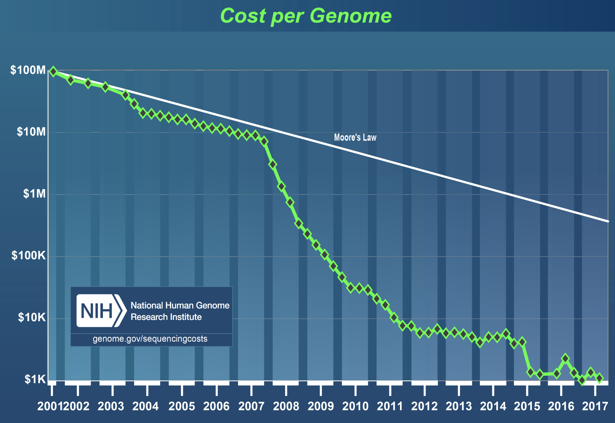
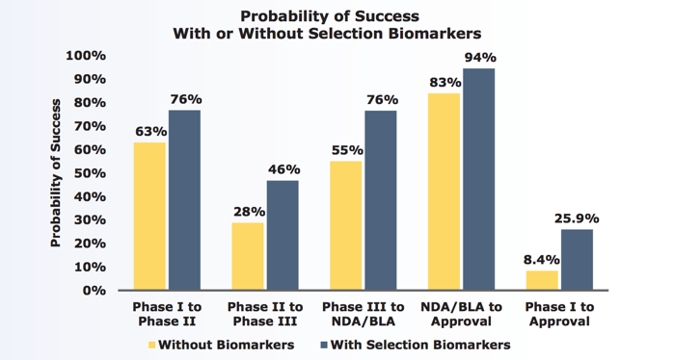
Genomics in Clinical Trials
Drivers are Cost and the Potential of Biomarkers
Wetterstrand KA. DNA Sequencing Costs: Data from the NHGRI Genome Sequencing Program (GSP). Available at: www.genome.gov/sequencingcostsdata. Accessed April 8, 2018
Clinical Development Success Rates 2006-2015, BIO, Biomedtracker, Amplion
22
Notes:
As you might have seen in the earlier talks of this session- Medidata’s data strategy can be broken down into this four bullet paradigm, enabled by the SaaS backbone built for Rave:
Working with customers to build effective software for managing data Ingestion and aggregation, and provide master data management across clinical, operational, and financial data
Automated and manual curation for single study and cross industry data
Application of Machine Learning, Natural Language Processing and Predictive Modeling on these standardized data
Delivering these data within the platform, with integrated Data Science and Data Discovery tools.
In this talk, we will delve deep into the scientific insights we are deriving with Rave Omics.

Slide 23
Challenge for Academia and Industry
Pipelines and Processes Are Not Optimized for Genomic Data
Speed, Efficiency, Audit Trail, Communication
Data from many sources
Centralize, Curate, QC &
Standardization
Subsets for specific workflows
Timely Analysis and Distribution of Results
23
Notes:
As you might have seen in the earlier talks of this session- Medidata’s data strategy can be broken down into this four bullet paradigm, enabled by the SaaS backbone built for Rave:
Working with customers to build effective software for managing data Ingestion and aggregation, and provide master data management across clinical, operational, and financial data
Automated and manual curation for single study and cross industry data
Application of Machine Learning, Natural Language Processing and Predictive Modeling on these standardized data
Delivering these data within the platform, with integrated Data Science and Data Discovery tools.
In this talk, we will delve deep into the scientific insights we are deriving with Rave Omics.

Slide 24




Ingesting and Centralizing Data
Data Pipes, Management, and Usage
MEDIDATA RAVE OMICS
Biostatisticans
MEDIDATA MEDS
ANALYTICS
MODULE
Site 1
QC
Site 2
...
CRF & ADaM Data
Site n
Summary Statistics
Samples
Subject
Efficacy
Analytics
Seq Lab- 1
...
Safety Analytics
‘omic Data
Auxiliary data
Seq Lab- n
Biostats and Data Teams
Notes:
As you might have seen in the earlier talks of this session- Medidata’s data strategy can be broken down into this four bullet paradigm, enabled by the SaaS backbone built for Rave:
Working with customers to build effective software for managing data Ingestion and aggregation, and provide master data management across clinical, operational, and financial data
Automated and manual curation for single study and cross industry data
Application of Machine Learning, Natural Language Processing and Predictive Modeling on these standardized data
Delivering these data within the platform, with integrated Data Science and Data Discovery tools.
In this talk, we will delve deep into the scientific insights we are deriving with Rave Omics.

Slide 25
Analytics for Genomic & Clinical Data
Clustering example
Notes:
As you might have seen in the earlier talks of this session- Medidata’s data strategy can be broken down into this four bullet paradigm, enabled by the SaaS backbone built for Rave:
Working with customers to build effective software for managing data Ingestion and aggregation, and provide master data management across clinical, operational, and financial data
Automated and manual curation for single study and cross industry data
Application of Machine Learning, Natural Language Processing and Predictive Modeling on these standardized data
Delivering these data within the platform, with integrated Data Science and Data Discovery tools.
In this talk, we will delve deep into the scientific insights we are deriving with Rave Omics.

Slide 26
Advanced Analytics
Regression Trees for Survival Data
Variable Importance
30
20
___
10
88 60
* ___High (≥9.9)
0
___ Low (<9.9)
___
Treatment & High
86 17
0.8
___ Low (<12)
___ High (≥12)
0.4
Treatment & Low
___
Non-___
Non-___
p = 0.00254
85 8
1 9
2 43
0.0
0
5
10
15
20
25
26
Notes:
As you might have seen in the earlier talks of this session- Medidata’s data strategy can be broken down into this four bullet paradigm, enabled by the SaaS backbone built for Rave:
Working with customers to build effective software for managing data Ingestion and aggregation, and provide master data management across clinical, operational, and financial data
Automated and manual curation for single study and cross industry data
Application of Machine Learning, Natural Language Processing and Predictive Modeling on these standardized data
Delivering these data within the platform, with integrated Data Science and Data Discovery tools.
In this talk, we will delve deep into the scientific insights we are deriving with Rave Omics.

Slide 27
Medidata’s Goal: Better Clinical Trials
Mobile Health
Study Design & Feasibility
Images Genomics RWE
Site Grants & Payments
Site & Lab Data
Rave
Edge
Strategic Monitoring
MEDS
& AI
Data Capture
& Management
Trial Planning
& Management
Random-ization & Supply
CTMS
Biostats &Safety
eTMF
Notes:
As you might have seen in the earlier talks of this session- Medidata’s data strategy can be broken down into this four bullet paradigm, enabled by the SaaS backbone built for Rave:
Working with customers to build effective software for managing data Ingestion and aggregation, and provide master data management across clinical, operational, and financial data
Automated and manual curation for single study and cross industry data
Application of Machine Learning, Natural Language Processing and Predictive Modeling on these standardized data
Delivering these data within the platform, with integrated Data Science and Data Discovery tools.
In this talk, we will delve deep into the scientific insights we are deriving with Rave Omics.

Slide 28
Thank you.
Steve Schwager sschwager@mdsol.com
Jason Mezey jmezey@mdsol.com
Notes:
Please stop but our booth to learn more about Rave Omics and all the other products that make up the Medidata Clinical Cloud.

